Slide 1


Noida Institute of Engineering and Technology, Greater Noida
Advanced NLP Techniques
Unit: 5
Natural Language Processing
Subject Code: ACSAI0712
Mr. M. Abdul Mateen Siddiqui
(Assistant Professor)
Department of CSE (Cyber Security)
Course Details B. Tech. VII Sem

Slide 2
Faculty Introduction
Name : Mr. M. Abdul Mateen Siddiqui
Qualification: B. Tech (CSE), M. Tech (CSE-CFIS), Ph. D (Pursuing)
Area of Specialization: Cyber Forensics, Information Security, Digital Forensics, Smart Wearable Devices and IoT Devices

Slide 3

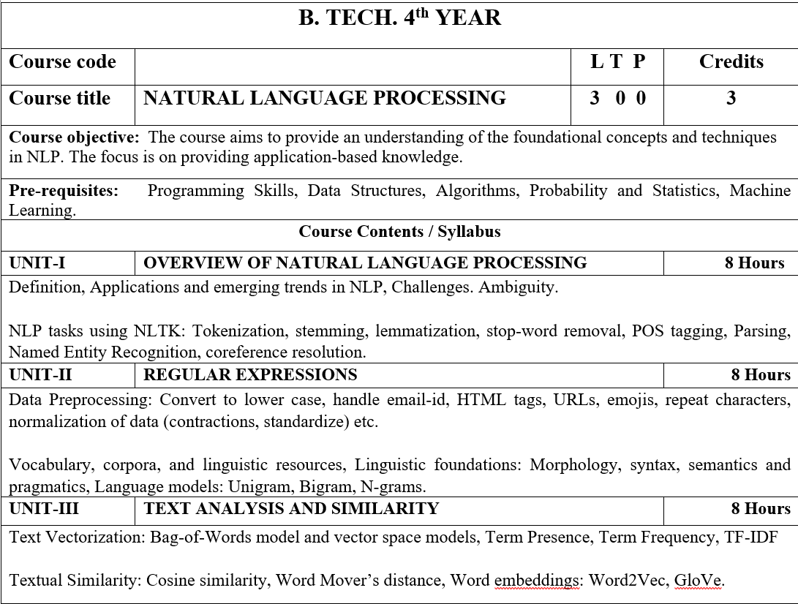
Syllabus

Slide 4
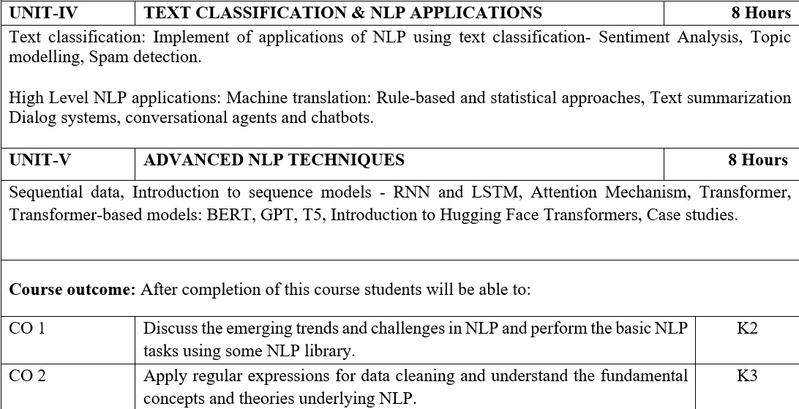
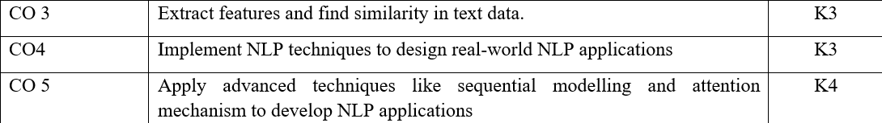
Syllabus

Slide 5
Video Links
https://realpython.com/nltk-nlp-python/
https://www.coursera.org/lecture/python-text-mining/basic-nlp-tasks-with-nltk-KD8uN
https://www.coursera.org/lecture/nlp-sequence-models/learning-word-embeddings-APM5s
https://www.coursera.org/projects/regular-expressions-in-python
https://www.coursera.org/learn/python-text-mining/lecture/sVe8B/regular-expressions

Slide 6
Course Objective
The course aims to provide an understanding of the foundational concepts and techniques in NLP.
The focus is on providing application-based knowledge.

Slide 7
Course Outcome
CO1 | Discuss the emerging trends and challenges in NLP and perform the basic NLP tasks using some NLP library. | K2
CO2 | Apply regular expressions for data cleaning and understand the fundamental concepts and theories underlying NLP. | K3
CO3 | Extract features and find similarity in text data. | K3
CO4 | Implement NLP techniques to design real-world NLP applications | K3
CO5 | Apply advanced techniques like sequential modelling and attention mechanism to develop NLP applications | K4

Slide 8
Program Outcome
1. Engineering knowledge: Apply the knowledge of mathematics, science, engineering fundamentals, and an engineering specialization for the solution of complex engineering problems.
2. Problem analysis: Identify, formulate, research literature, and analyze complex engineering problems reaching substantiated conclusions using first principles of mathematics, natural sciences, and engineering sciences.
3. Design/development of solutions: Design solutions for complex engineering problems and design system components or processes that meet the specified needs with appropriate consideration for public health and safety, and cultural, societal, and environmental considerations.

Slide 9
Program Outcome
4. Conduct investigations of complex problems: Use research based knowledge and research methods including design of experiments, analysis and interpretation of data, and synthesis of information to provide valid conclusions.
5. Modern tool usage: Create, select, and apply appropriate techniques, resources, and modern engineering and IT tools, including prediction and modeling to complex engineering activities, with an understanding of the limitations.
6. The engineer and society: Apply reasoning informed by the contextual knowledge to assess societal, health, safety, legal and cultural issues and the consequent responsibilities relevant to the professional engineering practice.

Slide 10
Program Outcome
7. Environment and sustainability: Understand the impact of the professional engineering solutions in societal and environmental contexts, and demonstrate the knowledge of, and need for sustainable development.
8. Ethics: Apply ethical principles and commit to professional ethics and responsibilities and norms of the engineering practice.
9. Individual and team work: Function effectively as an individual, and as a member or leader in diverse teams, and in multidisciplinary settings.

Slide 11
Program Outcome
10. Communication: Communicate effectively on complex engineering activities with the engineering community and with the society at large, such as, being able to comprehend and write effective reports and design documentation, make effective presentations, and give and receive clear instructions.
11. Project management and finance: Demonstrate knowledge and understanding of the engineering and management principles and apply these to one’s own work, as a member and leader in a team, to manage projects and in multidisciplinary environments.
12.Life-long learning: Recognize the need for, and have the preparation and ability to engage in independent and life-long learning in the broadest context of technological change.

Slide 12
Pre-requisites
Programming Skills,
Data Structures,
Algorithms,
Probability and Statistics,
Machine Learning.

Slide 13
Unit-5:Content
ADVANCED NLP TECHNIQUES:
Sequential data
Introduction to Sequence Models:
RNN
LSTM
Attention Mechanism
Transformer
Transformer-based Models:
BERT
GPT
T5
Introduction to Hugging Face Transformers
Case studies

Slide 14
What is Sequential Data?
Sequential Data in Natural Language Processing (NLP) refers to data that has an inherent order or sequence.
This order is crucial for understanding the context and meaning of the data.
In the context of NLP, sequential data often refers to sequences of words or characters in a text.
Understanding and modeling the sequential nature of language is essential for tasks such as language modeling, machine translation, text generation, sentiment analysis, and named entity recognition, among others.
In summary, Sequential Data in NLP is a fundamental aspect that requires specialized techniques to capture and leverage the inherent order and dependencies within the data.
Models and Architectures designed for sequential processing, such as RNNs, LSTMs, GRUs, attention mechanisms, and transformer models, play a crucial role in extracting meaningful information from sequences of text.

Slide 15
Some key aspects of Sequential Data in NLP:
3. Recurrent Neural Networks (RNNs): RNNs are a class of neural networks designed to work with sequential data. They maintain an internal state that is updated with each new input, allowing them to capture dependencies and relationships between elements in a sequence. Each time step in an RNN processes a new token in the sequence, and the hidden state is updated accordingly.
1. Tokenization: Tokenization is the process of breaking down a sequence of text into individual units, or tokens. In the case of language, tokens are often words or subwords. For example, the sentence "I love natural language processing" would be tokenized into the following tokens: ["I", "love", "natural", "language", "processing"].
2. Sequence Representation: Once tokenized, the sequential data needs to be represented in a format that can be processed by machine learning models. Common representations include numerical vectors or embeddings for each token. Embeddings capture semantic relationships between words and are used to represent words in a continuous vector space.
4. Long Short-Term Memory (LSTM) and Gated Recurrent Unit (GRU): Traditional RNNs can struggle with capturing long-term dependencies. LSTM and GRU are variants of RNNs designed to address this issue by introducing mechanisms to selectively remember or forget information. LSTMs and GRUs are better at handling vanishing or exploding gradient problems, making them more effective for modeling long sequences.

Slide 16
Some key aspects of Sequential Data in NLP:
6. Transformer Models: Transformers are a type of neural network architecture that has proven highly effective for sequential data in NLP. They use self-attention mechanisms to capture global dependencies in a sequence. Models like BERT (Bidirectional Encoder Representations from Transformers) and GPT (Generative Pre-trained Transformer) are based on the transformer architecture and have set state-of-the-art benchmarks in various NLP tasks.
5. Attention Mechanisms: Attention mechanisms enable models to focus on specific parts of the input sequence when making predictions. This is especially useful when dealing with long sequences, as it allows the model to weigh the importance of different elements dynamically. Transformer models, which have gained prominence in NLP, rely heavily on attention mechanisms.
7. Sequence Labeling: In many NLP applications, the goal is to assign labels to each element in a sequence. For example, named entity recognition involves labeling each word in a sentence with its corresponding entity type (e.g., person, organization, location). Conditional Random Fields (CRFs) and more recently, neural network-based approaches, are commonly used for sequence labeling tasks.
8. Temporal Aspect: Sequential data often has a temporal aspect, where the order of elements is crucial for understanding the meaning. This is particularly relevant in tasks like time series analysis and language modeling.

Slide 17
What is Sequence Models?
Sequence Models in Natural Language Processing (NLP) are a class of machine learning models designed to handle sequences of data, especially in the context of language.
These models are crucial for tasks where the order of the elements matters, such as predicting the next word in a sentence, language translation, sentiment analysis, and named entity recognition.
Two prominent types of sequence models used in NLP are Recurrent Neural Networks (RNNs) and LSTM.
In summary, Sequence Models, including RNNs and LSTM, play a pivotal role in NLP tasks by capturing dependencies and patterns in sequential data.
They have significantly advanced the state of the art in various language-related applications and continue to be a focal point of research and development in the field of NLP.

Slide 18
Applications of Sequence Models:
1. Language Modeling: Predicting the next word in a sequence of words, which is fundamental for understanding and generating human-like text.
2. Machine Translation: Translating text from one language to another by capturing the relationships between words in the source and target languages.
3. Named Entity Recognition (NER): Identifying and classifying entities (such as persons, organizations, and locations) in a text.
4. Sentiment Analysis: Determining the sentiment expressed in a piece of text, whether it is positive, negative, or neutral.
5. Speech Recognition: Converting spoken language into written text by modeling the sequential patterns in audio data.
6. Text Generation: Generating coherent and contextually relevant text, which is useful for chatbots, content creation, and creative writing.

Slide 19
What is RNN Sequence Model?
Recurrent Neural Networks (RNNs) are a type of sequence model widely used in Natural Language Processing (NLP) to handle sequential data, such as text.
RNNs are designed to capture dependencies and patterns in sequences, making them suitable for tasks where the order of elements matters, like language modeling, machine translation, sentiment analysis, and more.
RNNs have played a significant role in advancing the field of NLP.
They form the foundation for more complex architectures and continue to be used in certain applications where sequential processing is essential.

Slide 20
Some key aspects of RNN Sequence Model:
1. Concept: RNNs are neural networks with an internal state that is updated with each new element in a sequence. This internal state serves as a form of memory, allowing the network to capture information from previous elements in the sequence.
2. Architecture:
- At each time step, an RNN takes an input, processes it along with the hidden state from the previous time step, and produces an output and a new hidden state.
- The output is often used for the task at hand (e.g., predicting the next word), and the hidden state retains information about the sequence seen so far.
- The recurrence in RNNs allows them to maintain a sense of context and consider the entire sequence when making predictions.
3. Challenges:
- Vanishing Gradient Problem: RNNs can struggle with capturing long-term dependencies in sequences due to the vanishing gradient problem. Gradients become extremely small during backpropagation, hindering the model's ability to learn from distant elements.
- Exploding Gradient Problem: Alternatively, gradients can explode in certain cases, leading to unstable training.

Slide 21
Some key aspects of RNN Sequence Model:
4. Variants:
- Long Short-Term Memory (LSTM): LSTMs are a variant of RNNs designed to address the vanishing gradient problem. They incorporate memory cells and gating mechanisms to selectively retain or forget information.
- Gated Recurrent Unit (GRU): GRUs are another variant that simplifies the architecture compared to LSTMs while still addressing the vanishing gradient problem.
5. Applications in NLP:
- Language Modeling: Predicting the next word in a sentence.
- Text Generation: Generating coherent and contextually relevant text.
- Machine Translation: Translating text from one language to another.
- Named Entity Recognition (NER): Identifying entities (e.g., names, organizations) in a text.
- Speech Recognition: Converting spoken language into written text.
6. Bidirectional RNNs:
- Bidirectional RNNs process the sequence in both forward and backward directions. This helps capture information from both past and future contexts, enhancing the model's understanding of the sequence.
7. Limitations:
- RNNs have limitations in capturing long-range dependencies due to the sequential nature of their processing. More recent architectures like Transformers have addressed these limitations.

Slide 22
What is LSTM Sequence Model?
Long Short-Term Memory (LSTM) is a specialized type of recurrent neural network (RNN) architecture designed to address the vanishing gradient problem in traditional RNNs.
LSTMs are particularly effective in capturing long-term dependencies in sequential data, making them well-suited for Natural Language Processing (NLP) tasks.
In summary, LSTMs are a key advancement in the field of NLP, providing an effective solution for modeling and learning from sequential data with long-term dependencies.
Their ability to capture context and relationships in language has contributed significantly to the success of various NLP applications.

Slide 23
Some key aspects of LSTM Sequence Model:
1. Concept:
- LSTMs were introduced to overcome the limitations of traditional RNNs in capturing long-term dependencies in sequences.
- The key idea is to introduce memory cells and gating mechanisms that allow the network to selectively retain or forget information from previous time steps.
2. Architecture:
- The LSTM cell consists of three main components:
Cell State: Represents the long-term memory of the cell.
Hidden State: Represents the short-term memory or output of the cell.
Gates: Mechanisms that control the flow of information.
3. Gating Mechanisms:
- Input Gate: Controls the input information.
- Forget Gate: Controls what information should be discarded from the cell state.
- Output Gate: Controls the information to be output from the cell.
4. Advantages:
- Long-Term Dependencies: LSTMs excel at capturing dependencies over long sequences.
- Reduced Vanishing Gradient Problem: The gating mechanisms help mitigate the vanishing gradient problem, allowing the model to learn more effectively.

Slide 24
Some key aspects of LSTM Sequence Model:
5. Applications in NLP:
- Language Modeling: Predicting the next word in a sequence.
- Machine Translation: Translating text from one language to another.
- Text Generation: Generating coherent and contextually relevant text.
- Sentiment Analysis: Analyzing and determining the sentiment expressed in a piece of text.
- Named Entity Recognition (NER): Identifying and classifying entities (e.g., persons, organizations) in a text.
6. Variants:
- Variants of LSTMs, such as peephole connections and coupled forget and input gates, have been proposed to further enhance their capabilities.
7. Limitations:
- While LSTMs are powerful, they may still face challenges in capturing certain types of dependencies in extremely long sequences.
- Training large LSTM models can be computationally intensive.

Slide 25
What is Attention Mechanism?
Attention Mechanism is a fundamental concept in Natural Language Processing (NLP) that enhances the ability of models to focus on different parts of input sequences when making predictions or generating outputs.
In summary, the attention mechanism in NLP allows models to selectively focus on different parts of the input sequence, enhancing their ability to capture dependencies and relationships.
It allows models to selectively attend to relevant information, giving them the capacity to handle long-range dependencies and capture intricate patterns in the data.
The attention mechanism has been particularly influential in the success of transformer-based models.
It has become a key building block in modern NLP architectures, enabling the development of highly effective and context-aware models.

Slide 26
What is Transformer?
The Transformer is a groundbreaking architecture in Natural Language Processing (NLP) that was introduced in the paper "Attention is All You Need" by Vaswani et al. in 2017.
The Transformer architecture has had a transformative impact on NLP, leading to the development of highly efficient and powerful models.
It has since become the foundation for numerous state-of-the-art models in NLP due to its ability to capture long-range dependencies efficiently and parallelize computations.
The Transformer architecture is particularly known for its attention mechanism and self-attention mechanism, which allow models to focus on different parts of input sequences selectively.
Its attention mechanism and self-attention mechanism have become integral components in many subsequent architectures, making it a cornerstone in the evolution of deep learning in natural language understanding and generation tasks.

Slide 27
Applications of Transformer:
5. Language Understanding: Transformers have been widely adopted for tasks that require a deep understanding of language, such as sentiment analysis and natural language inference.
1. BERT (Bidirectional Encoder Representations from Transformers): BERT is a pre-trained transformer model that has set benchmarks in various NLP tasks, including question answering, sentiment analysis, and named entity recognition.
2. GPT (Generative Pre-trained Transformer): GPT is a series of transformer-based language models that excel at generating coherent and contextually relevant text.
3. Transformer-based Models in Machine Translation: The transformer's ability to capture long-range dependencies has significantly improved the quality of machine translation models.
4. Text Summarization: Transformers are effective in summarizing long documents by attending to important parts of the input text.

Slide 28
What is Transformer-based Models?
Transformer-based Models represent a family of neural network architectures that have revolutionized Natural Language Processing (NLP).
In summary, transformer-based models have had a transformative impact on NLP, pushing the boundaries of performance on a wide range of tasks.
Introduced by Vaswani et al. in the paper "Attention is All You Need" in 2017, the Transformer architecture has become the basis for various state-of-the-art models.
Transformer-based models leverage self-attention mechanisms to capture contextual information effectively, allowing them to model dependencies across long sequences efficiently.
Their ability to capture context and dependencies efficiently has made them the go-to architecture for various applications, and they continue to be a focal point of research and development in the field of natural language understanding and generation.

Slide 29
Key Characteristics of Transformer-based Models:
1. Self-Attention Mechanism: The self-attention mechanism enables models to weigh different parts of the input sequence differently, capturing long-range dependencies. It computes attention scores for each element in the sequence based on its relationship with a query vector, allowing the model to focus on relevant information.
2. Multi-Head Attention: To capture different aspects of the input, attention is computed in parallel with multiple sets of query, key, and value vectors, known as attention heads. The results from multiple heads are concatenated and linearly transformed to produce the final output of the attention layer.
7. Layer Normalization and Residual Connections: Each sub-layer (attention, feedforward) in the transformer block is followed by layer normalization and a residual connection. These components contribute to the stability and training efficiency of the model.
3. Positional Encoding: Transformers do not inherently understand the order of elements in a sequence since they operate independently of position. Positional encoding is added to the input embeddings to provide information about the position of each element in the sequence.
4. Encoder and Decoder Stacks: Transformer-based models typically consist of an encoder stack and a decoder stack. The encoder processes the input sequence, and the decoder generates the output sequence. The decoder stack includes an additional cross-attention layer, allowing it to attend to the encoder's output.
5. Attention Isolation: Transformers allow each position in the input sequence to attend to all positions simultaneously, capturing global dependencies efficiently. This is in contrast to traditional sequential models like RNNs, where dependencies are captured sequentially.
6. Feedforward Neural Network: Each attention layer in the transformer is followed by a feedforward neural network that processes the attended information independently. The feedforward network typically consists of fully connected layers with a non-linear activation function.

Slide 30
Applications of Transformer-based Models:
1. BERT (Bidirectional Encoder Representations from Transformers):
- BERT is a pre-trained transformer model that learns contextualized representations of words by considering both left and right context in a bidirectional manner.
- BERT has achieved state-of-the-art results in a wide range of NLP tasks, including question answering, sentiment analysis, and named entity recognition.
2. GPT (Generative Pre-trained Transformer):
- GPT is a series of transformer-based language models that use a unidirectional architecture for autoregressive language modeling.
- GPT models are capable of generating coherent and contextually relevant text.
3. Transformer-based Machine Translation Models:
- Transformers have significantly improved the quality of machine translation models by capturing long-range dependencies effectively.
4. XLNet:
- XLNet is another transformer-based model that extends BERT by incorporating elements of autoregressive language modeling and permutation language modeling.
5. T5 (Text-To-Text Transfer Transformer):
- T5 treats all NLP tasks as a text-to-text problem, unifying various tasks like translation, summarization, and question answering under a single framework.

Slide 31
Benefits & Limitations of Transformer-based Models:
Benefits:
- Parallelization: Transformers enable parallelization of training and inference, making them computationally efficient.
- Scalability: The architecture scales well with larger datasets and model sizes.
- Transfer Learning: Pre-training on large corpora allows transformer-based models to transfer knowledge effectively to downstream tasks.
Limitations:
- Computational Resources: Training large transformer models can be computationally expensive.
- Attention Overhead: The self-attention mechanism introduces quadratic complexity in terms of sequence length, which can be limiting for very long sequences.

Slide 32
What is BERT Transformer-based Model?
BERT (Bidirectional Encoder Representations from Transformers) is a revolutionary transformer-based model in Natural Language Processing (NLP).
BERT has significantly advanced the field of NLP, and its success has led to the development of various transformer-based models for language understanding and generation.
It was introduced by researchers at Google in the paper "BERT: Pre-training of Deep Bidirectional Transformers for Language Understanding" in 2018.
BERT has set new benchmarks in various NLP tasks by learning contextualized word representations in a bidirectional manner.
Researchers continue to explore extensions and improvements to the BERT architecture, contributing to the ongoing evolution of NLP models.

Slide 33
Key Characteristics of BERT Transformer-based Model:
1. Bidirectional Context Modeling:
- BERT introduces bidirectional context modeling by considering both left and right context for each word during pre-training.
- Traditional models, such as LSTMs and GRUs, process text in a sequential manner, missing out on global context information.
2. Pre-training Objectives:
- BERT is pre-trained on massive amounts of unlabeled text using two unsupervised objectives:
a. Masked Language Model (MLM): Randomly mask out words in the input sequence, and the model is trained to predict the masked words based on their context.
b. Next Sentence Prediction (NSP): Given two consecutive sentences, the model is trained to predict whether the second sentence follows the first.
3. Transformer Architecture:
- BERT employs the transformer architecture, consisting of an encoder stack with self-attention mechanisms.
- The self-attention mechanism allows the model to weigh different parts of the input sequence differently, capturing dependencies efficiently.
4. Pre-training and Fine-tuning:
- BERT is pre-trained on large corpora, and the pre-trained model can be fine-tuned for specific downstream tasks such as text classification, named entity recognition, and question answering.
5. Contextualized Word Embeddings:
- BERT generates contextualized word embeddings that capture the meaning of a word based on its surrounding context.
- Contextual embeddings are crucial for capturing polysemy and resolving word ambiguity.
6. Attention Heads:
- BERT employs a multi-head attention mechanism, allowing the model to attend to different parts of the input sequence simultaneously.
- Multiple attention heads capture different patterns and relationships in the data.

Slide 34
Applications of BERT Transformer-based Model:
1. Text Classification:
- BERT has been widely used for tasks such as sentiment analysis, topic classification, and spam detection.
2. Named Entity Recognition (NER):
- BERT excels at identifying and classifying entities (e.g., names, organizations) in a text.
3. Question Answering:
- BERT-based models have achieved state-of-the-art results in question answering tasks, such as the Stanford Question Answering Dataset (SQuAD).
4. Semantic Similarity:
- BERT embeddings can be used to measure semantic similarity between sentences or documents.
5. Language Understanding:
- BERT is effective for various tasks that require a deep understanding of language, including paraphrase detection and natural language inference.

Slide 35
Benefits & Limitations of BERT Transformer-based Model:
Benefits:
- Contextual Embeddings: BERT provides contextualized word embeddings, capturing nuances in meaning.
- Transfer Learning: Pre-trained BERT models can be fine-tuned on smaller labeled datasets for specific tasks, leading to improved performance.
Limitations:
- Computational Resources: Training and fine-tuning large BERT models can be computationally expensive.
- Model Size: The larger BERT models may have limitations in deployment on resource-constrained devices.

Slide 36
What is GPT Transformer-based Model?
GPT (Generative Pre-trained Transformer) is a family of transformer-based language models in Natural Language Processing (NLP) developed by OpenAI.
GPT models have significantly advanced the capabilities of language models and have been applied in various domains.
The GPT models are known for their ability to generate coherent and contextually relevant text, demonstrating state-of-the-art performance in a variety of language tasks.
The GPT architecture was introduced in a series of papers, starting with "Improving Language Understanding by Generative Pretraining" in 2018, followed by GPT-2 and GPT-3.
Their generative nature, combined with powerful contextual understanding, makes them versatile tools for a wide range of NLP tasks.
Ongoing research in transformer-based models continues to explore ways to enhance efficiency, reduce biases, and improve the interpretability of these models.

Slide 37
Key Characteristics of GPT Transformer-based Model:
1. Generative Pre-training:
- GPT models are pre-trained on massive amounts of unlabeled text data, learning to predict the next word in a sentence.
- Pre-training allows the model to capture contextualized representations of words and understand the syntactic and semantic structures of language.
2. Unidirectional Language Modeling:
- GPT follows a unidirectional language modeling approach, where it predicts the next word in a sentence based on the preceding context.
- Unlike BERT, which uses bidirectional context, GPT generates text in a left-to-right manner, considering only the left context during training.
3. Transformer Architecture:
- GPT employs the transformer architecture, consisting of a stack of transformer decoder layers.
- The transformer architecture enables efficient processing of sequential data by utilizing self-attention mechanisms.
4. Attention Mechanism:
- The attention mechanism in GPT allows the model to weigh different parts of the input sequence differently, capturing dependencies across varying distances.
- GPT uses scaled dot-product attention to compute attention scores.
5. Layer Normalization and Residual Connections:
- Each layer in the GPT transformer block is followed by layer normalization and a residual connection.
- These components contribute to the stability and training efficiency of the model.
6. Positional Encoding:
- GPT incorporates positional encoding to provide information about the position of each word in the sequence.
- Positional encoding is crucial for the model to understand the sequential order of words.

Slide 38
Applications of GPT Transformer-based Model:
1. Text Generation:
- GPT is widely used for generating coherent and contextually relevant text, making it suitable for applications like content creation, creative writing, and story generation.
2. Language Translation:
- GPT-based models can be fine-tuned for language translation tasks, generating translations that capture the nuances of the input text.
3. Question Answering:
- GPT models demonstrate strong performance in question answering tasks, where they generate relevant and detailed answers based on input questions.
4. Summarization:
- GPT is capable of generating concise and informative summaries of longer texts.
5. Conversational Agents:
- GPT-based models can be used to create conversational agents that generate natural and context-aware responses.

Slide 39
Benefits & Limitations of GPT Transformer-based Model:
Benefits:
- Generative Capability: GPT models exhibit strong generative capabilities, allowing them to produce human-like text.
- Transfer Learning: Pre-training on diverse text data enables GPT models to transfer knowledge effectively to downstream tasks.
Limitations:
- Limited Bidirectional Context: GPT's unidirectional approach might result in limitations in capturing bidirectional context and dependencies.

Slide 40
What is T5 Transformer-based Model?
T5 (Text-To-Text Transfer Transformer) is a transformer-based model in Natural Language Processing (NLP).
T5 has demonstrated strong performance across a wide range of NLP tasks, showcasing the potential of a unified text-to-text approach.
It is introduced by researchers at Google in the paper "Exploring the Limits of Transfer Learning with a Unified Text-to-Text Transformer" in 2019.
T5 is distinctive in its approach, treating all NLP tasks as a text-to-text problem, unifying various tasks under a single framework.
This enables T5 to seamlessly handle a wide range of NLP tasks using a consistent input-output format.
Its versatility and effectiveness make it a valuable tool for researchers and practitioners working on various natural language understanding and generation challenges.

Slide 41
Key Characteristics of T5 Transformer-based Model:
1. Text-to-Text Framework:
- T5 adopts a unified framework where all NLP tasks are cast as a text-to-text problem.
- Inputs and outputs are both treated as textual sequences, and tasks are specified through prefixes in the input text.
2. Pre-training and Fine-tuning:
- T5 is pre-trained on a large corpus of diverse text using a denoising autoencoder objective, where parts of the input text are masked, and the model is trained to reconstruct the original text.
- The pre-trained model can be fine-tuned for various downstream tasks by providing task-specific prefixes.
3. Transformer Architecture:
- T5 employs the transformer architecture, similar to models like BERT and GPT, with stacked layers of self-attention mechanisms.
- The transformer enables efficient processing of sequential data and capturing contextual information.
4. Task-Agnostic Model:
- T5 is designed to be task-agnostic, meaning that it can handle a diverse set of tasks without task-specific modifications to the model architecture.
- The same model can be fine-tuned for tasks like translation, summarization, question answering, and more.
5. Positional Encoding:
- T5 includes positional encoding to provide information about the position of each word in the sequence.
- Positional encoding is crucial for the model to understand the sequential order of words.

Slide 42
Applications of T5 Transformer-based Model:
1. Text Summarization:
- T5 can be fine-tuned for summarization tasks, where it generates concise and informative summaries of input text.
2. Translation:
- T5 is effective for language translation tasks, producing translations that capture the nuances of the input text.
3. Question Answering:
- T5 can be fine-tuned for question answering tasks, generating relevant and detailed answers based on input questions.
4. Text Classification:
- T5 can handle text classification tasks by generating class labels or relevant categories for input text.
5. Named Entity Recognition (NER):
- T5 can be applied to NER tasks by generating sequences that identify and classify named entities.

Slide 43
Benefits & Limitations of T5 Transformer-based Model:
Benefits:
- Unified Framework: T5's text-to-text approach provides a unified framework for handling diverse NLP tasks without the need for task-specific architectures.
- Transfer Learning: Pre-training on a large corpus allows T5 to transfer knowledge effectively to various downstream tasks.
Limitations:
- Computational Resources: Training and fine-tuning large T5 models can be computationally expensive.
- Model Size: Large model sizes may have limitations in deployment on resource-constrained devices.

Slide 44
Introduction to Hugging Face Transformers:
Hugging Face Transformers is an open-source library and platform that provides a collection of pre-trained transformer-based models for Natural Language Processing (NLP).
Hugging Face Transformers has become a go-to resource for researchers, practitioners, and developers in the NLP community.
It is developed by Hugging Face, a company dedicated to democratizing AI and making state-of-the-art models accessible to the broader community.
The library serves as a hub for transformer models, offering a unified interface for working with various NLP tasks and architectures.
Its extensive collection of pre-trained models, unified API, and active community make it a powerful tool for a wide range of NLP applications.

Slide 45
Key Features & Components of Hugging Face Transformers:
1. Extensive Model Hub: Hugging Face Transformers provides a model hub that hosts a wide variety of pre-trained transformer models. These models cover different architectures (e.g., BERT, GPT, T5) and are trained on diverse datasets for various NLP tasks.
2. Unified API: The library offers a consistent and user-friendly API that allows users to seamlessly switch between different transformer models without needing to modify their code significantly.
3. Model Training and Fine-Tuning: Hugging Face Transformers supports training and fine-tuning of transformer models on custom datasets. Users can adapt pre-trained models to specific tasks or domains.
4. Common NLP Tasks: The library is designed to handle common NLP tasks such as text classification, named entity recognition, question answering, text generation, translation, and more.
5. Tokenization and Data Processing: Hugging Face Transformers provides tokenizers and data processing utilities that make it easy to prepare input data for transformer models.
6. Model Pipelines: Users can leverage pre-built pipelines for various tasks, simplifying the process of using transformer models for specific applications.
7. Community Contributions: The library benefits from a vibrant community that contributes models, scripts, and tutorials. Users can explore and build upon the collective knowledge of the community.
8. Integration with Other Libraries: Hugging Face Transformers integrates seamlessly with other popular deep learning libraries such as PyTorch and TensorFlow, making it accessible to users with different preferences.

Slide 46
Workflow with Hugging Face Transformers:
1. Install the Library: Users can install the Hugging Face Transformers library using pip: `pip install transformers`.
3. Tokenization and Input Preparation: Tokenize and prepare input data using the provided tokenizers and utilities. These ensure that the input is compatible with the chosen transformer model.
4. Instantiate the Model: Instantiate the selected model using the Hugging Face Transformers API. Models are loaded with pre-trained weights.
5. Inference and Fine-Tuning: Use the model for inference on new data or fine-tune it on custom datasets for specific tasks.
6. Model Evaluation: Evaluate the model's performance on task-specific metrics. Hugging Face Transformers often includes metrics functions for common NLP tasks.
2. Choose a Model: Select a pre-trained model suitable for the task at hand from the model hub. Models are available for various architectures and tasks.

Slide 47
Benefits & Limitations of Hugging Face Transformers:
Benefits:
- Model Reusability: Easily switch between different transformer models for experimentation or production use.
- Community Support: Access a large and active community for support, contributions, and sharing of models.
- Accelerated Development: Hugging Face Transformers streamlines the development process by providing pre-trained models and consistent APIs.
Limitations:
- Computational Resources: Fine-tuning and training large models may require significant computational resources.
- Learning Curve: While the library is user-friendly, working with transformer models might have a learning curve for users new to deep learning and NLP.

Slide 48
Case Study : 1
Title: Improving Customer Support with Sentiment Analysis using Hugging Face Transformers
Objectives:
1. Analyse customer sentiment in reviews to understand overall satisfaction levels.
2. Identify common issues or pain points mentioned by customers.
3. Provide actionable insights to improve customer support and overall user experience.
Methodology:
1. Data Collection:
- Gather a dataset of customer reviews from various sources, such as online reviews, support tickets, and surveys.
- Annotate the dataset with sentiment labels (positive, negative, neutral).
2. Data Preprocessing:
- Tokenize and preprocess the text data using Hugging Face Transformers' tokenization utilities.
- Split the dataset into training and testing sets.
3. Model Selection:
- Choose a pre-trained sentiment analysis model from the Hugging Face model hub, such as a BERT-based model.
- Fine-tune the selected model on the annotated dataset for sentiment analysis.
4. Model Evaluation:
- Evaluate the fine-tuned model on the testing set using metrics like accuracy, precision, recall, and F1-score.
- Analyse the model's performance on different sentiment classes.

Slide 49
Case Study : 1
5. Insights and Recommendations:
- Extract insights from the sentiment analysis results, identifying recurring themes in positive and negative feedback.
- Provide actionable recommendations to improve customer support based on the identified issues.
6. Implementation:
- Implement changes in the customer support process based on the insights gained from the sentiment analysis.
- Monitor the impact of the changes over time.
Results:
1. The sentiment analysis model achieved high accuracy in predicting customer sentiment.
2. Common issues highlighted in negative reviews were addressed, leading to an improvement in overall customer satisfaction.
3. The customer support team reported a decrease in the resolution time for identified issues.
Conclusion:
The integration of Hugging Face Transformers for sentiment analysis proved to be effective in gaining actionable insights from customer feedback. The company successfully improved its customer support process, leading to a more positive user experience.

Slide 50
Case Study : 2
Title: Enhancing Customer Feedback Analysis in E-Commerce with Hugging Face Transformers
Objectives:
1. Analyze customer sentiment in product reviews to understand overall satisfaction levels.
2. Identify key product features mentioned in positive and negative reviews.
3. Develop a recommendation system based on customer preferences extracted from reviews.
Methodology:
1. Data Collection:
- Gather a large dataset of product reviews from the e-commerce platform, spanning various product categories.
- Annotate the dataset with sentiment labels (positive, negative, neutral).
2. Data Preprocessing:
- Clean and preprocess the text data, including removing stop words, punctuation, and handling rare words.
- Tokenize the text using Hugging Face Transformers' tokenization tools.
3. Model Selection:
- Choose a pre-trained sentiment analysis model from the Hugging Face model hub, such as a BERT-based model.
- Fine-tune the selected model on the annotated dataset for sentiment analysis.
4. Aspect-Based Sentiment Analysis:
- Extend the analysis to perform aspect-based sentiment analysis to identify sentiments related to specific product features (e.g., design, usability, shipping).

Slide 51
Case Study : 2
5. Recommendation System:
- Develop a recommendation system that suggests products to users based on their past reviews and sentiments.
- Utilize collaborative filtering and NLP techniques to personalize recommendations.
6. Model Evaluation:
- Evaluate the sentiment analysis model on a separate testing dataset using metrics like accuracy, precision, recall, and F1-score.
- Assess the effectiveness of the recommendation system through A/B testing.
Results:
1. Sentiment Analysis:
- The sentiment analysis model achieved high accuracy, providing accurate sentiment labels for reviews.
- Positive sentiments were often associated with product quality, while negative sentiments were linked to issues with shipping and customer service.
2. Aspect-Based Analysis:
- Identified specific product features that received positive or negative feedback, providing actionable insights for product improvement.
3. Recommendation System:
- The recommendation system successfully personalized product suggestions for users based on their expressed preferences in reviews.
- Increased user engagement and satisfaction with the platform.
Conclusion:
The integration of Hugging Face Transformers for sentiment analysis and aspect-based analysis proved invaluable in understanding customer sentiment and preferences. The developed recommendation system contributed to a more personalized and satisfying shopping experience for users on the e-commerce platform.

Slide 52

THANK YOU

